Slide 1

ONLINE STORE
E-COMMERCE
creative
January 2025
POWERBI

Slide 2

TABLE OF
CONTENTS
01
Introduction
02
Problem statement
03
Objective
04
Data Preparation
05
Results
06
Conclusions
07
08
Recommendations
Future scope
Our content today is
divided into eight parts.

Slide 3



INTRODUCTION
Background
E-commerce industry is rapidly growing with an increase in customer expectations for personalized shopping
Thus, innovative strategies to attract and retain customers are sought after
Data information
The dataset provided for this project is from Online store in Brazil.

Slide 4





PROBLEM STATEMENT
Challenge in attracting and retaining customers
E-commerce companies struggle in attracting and retaining customers due to high competition and ever changing consumer preferences
Lack of personalized recommendations
This can lead to low customer engangement and decreased sales
Ineffective utilization of customer data limits
Customer data analysis helps to identify trends, customers product preferences and suggest relevant products

Slide 5





OBJECTIVE
Develop an intuitive and comprehensive dashboard for an online store to help understand their customers using PowerBI.
USER-FRIENDLY
IMPROVE DECISION-MAKING

Slide 6

DATA PREPARATIOON
RAW DATA DESCRIPTION
Name | Data details
Sheets | Two data sheets : Customer and Purchase
Data shape | Customer: 7 columns and 1001 rows Purchase: 11 columns and 50 000 rows
Column names | Customer: customer_id, first_name, last_name, gender, age, country and income Purchase: order_id, customer_id, product_name, description, price, discount, tax, order_date, quantity, shipping_cost and shipping_date

Slide 7
DATA PREPARATIOON
DATA TRANSFORMATION AND ANALYSIS
Action | Details
New columns | customer: Age Group Purchase: Total Discount, Net Price, Total Cost, Order Value, Shipping Days, Shipping Days Abs, Revenue, Customer Segment
Measures | Purchase: Cumulative New Cu, stomers, First Order Date, Repeat Customers Percentage, Total Customers, Total Orders

Slide 8
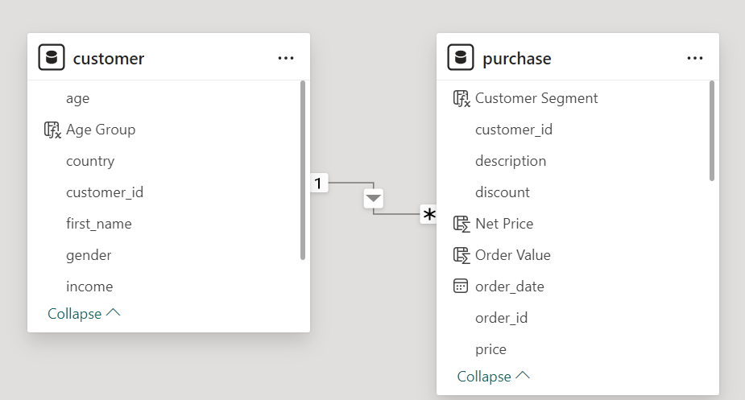
DATA PREPARATIOON
DATA MODEL
Customer and Purchase sheet are are linked through customer_id

Slide 9


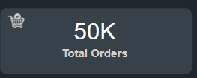
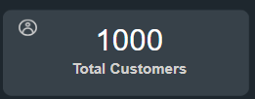
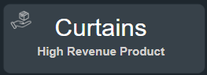
RESULTS
KEY PERFORMANCE INDICATORS, KPI
Revennue totals $277M which is greatly influenced by the high revenue product, “curtains”.
Seems to be a good retain of customers, with distinct customers of 1000 there are total orders of 50k.

Slide 10

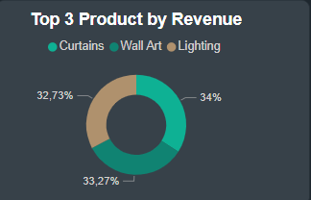
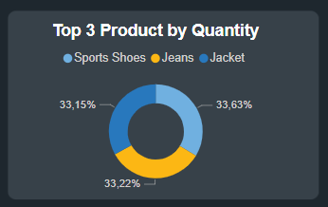

RESULTS
Product insights
High revenue products
Curtains, Wall art and lighting are the top 3 leading high revenue products
Top selling products
Sports shoes, Jeans and jackets are high selling products in terms of quantity

Slide 11

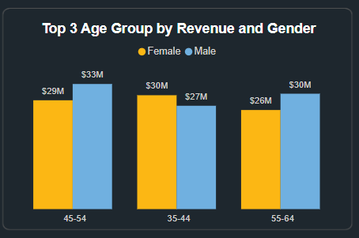
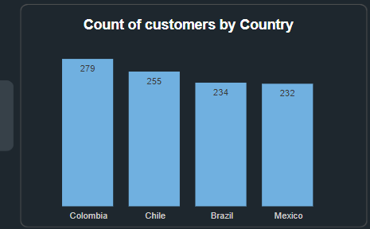
BUSINESS
GRAPH
Customer insights
Most of the customers from Shopee are from Columbia by a small margin, followed by Chile
45-54 age group bring most of the revenue especially the males.

Slide 12
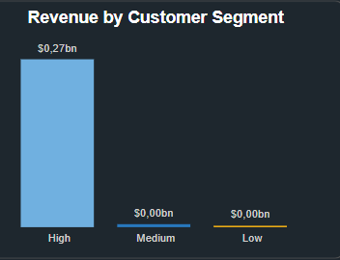
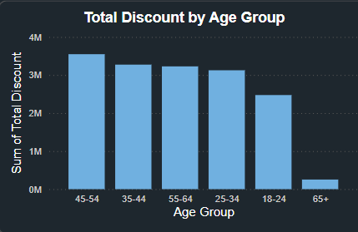
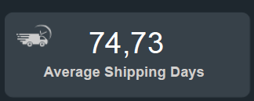
RESULTS
Purchasing behaviour
45-54 age group seem to prefer discounts more, followed by ages between 35 - 44 and 55 - 64
However, majority of the customers seem to be high spenders with revenue of $0,27bn.
The company has high shipping days which negatively affects the revenue, the higher the days the lesser the revenue

Slide 13


CONCLUSIONS
Curtains are highest revenue-generating product
Sports Shoes are top selling product by quantity
Customer base is almost evenly split between male and female
Age group of 45-54 generates the highest revenue
Colombia leads in both revenue and quantity among the countries

Slide 14

RECOMMENDATIONS
Focus marketing on curtains and sports shoes due to their high performance
Optimize shipping processes to reduce average shipping shipping days
Enhance customer retention strategies as there is a high percentage of repeat customers

Slide 15




FUTURE SCOPE
Increase market share
New product lines
Marketing campaigns
Explore opportunities to increase market share in underperforming countries.
Introduce new product lines or variations in top-performing categories to boost sales.
Implement targeted marketing campaigns for different age

Slide 16

THANK YOU

